Slide 1
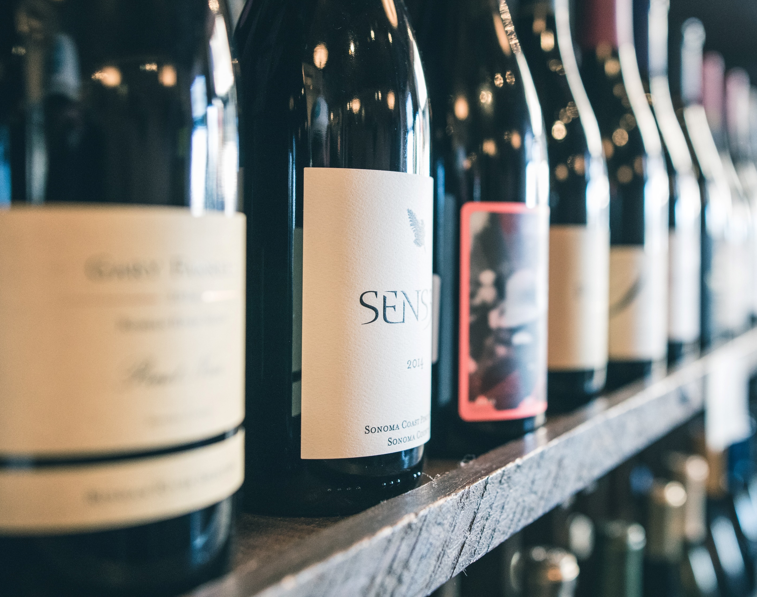
Vintly
The Winemaker’s Quality Predictor

Slide 2
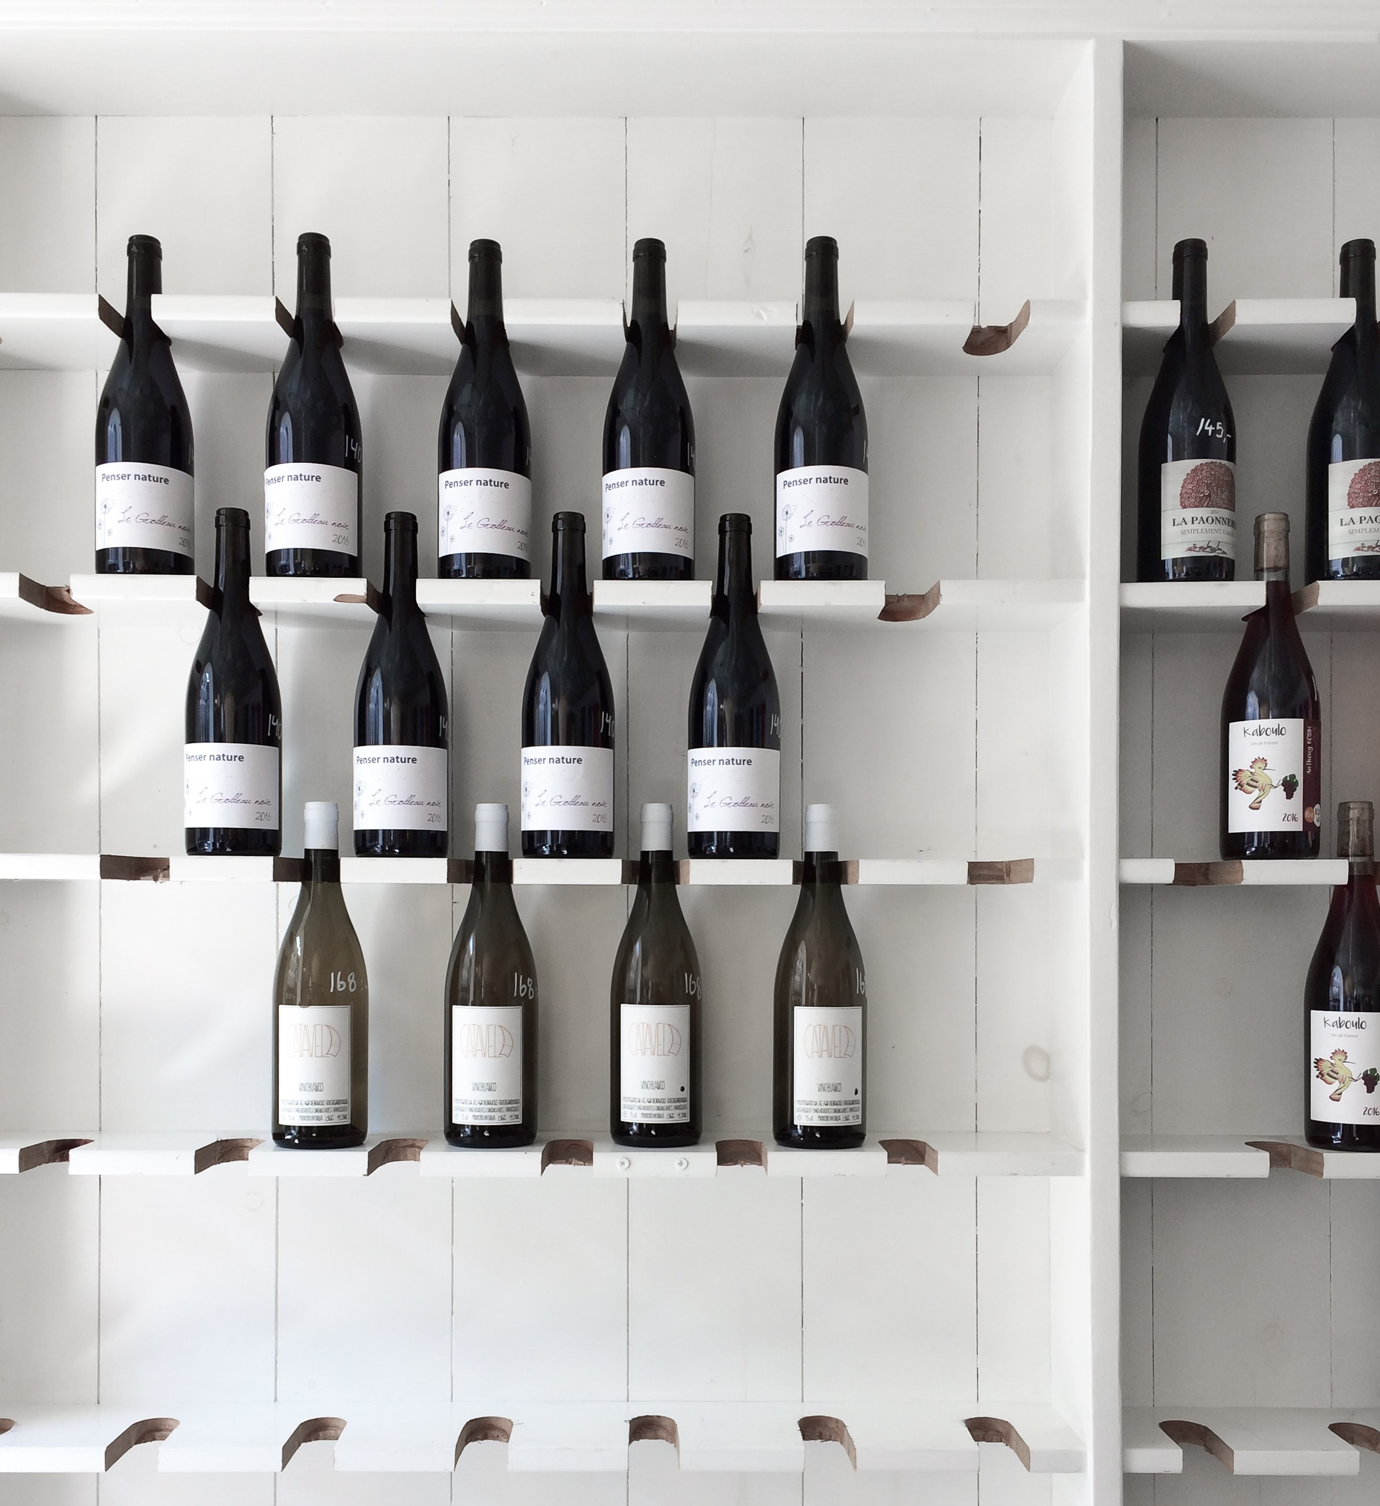
The Problem
How can winemakers determine whether their wine will be considered high or low quality? In order to
1. Inform Pricing
Without having a board of professional graders on hand, how can they make informed decisions?
2. Modify Production
Add more or less of a certain compound for a current harvest
Citric acid
Chlorides (salt)
Modify fermentation process for the future harvests
Ferment longer for less residual sugar
Expose to less oxygen to lower volatile acidity

Slide 3
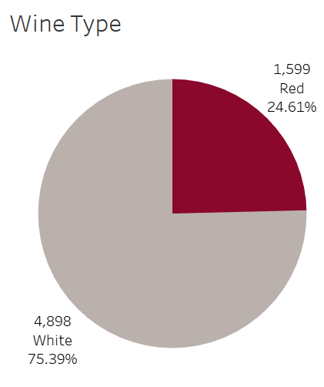
The Data
Over 6000 wines
11 physiochemical property inputs (Objective)
Fixed Acidity
Volatile acidity
Citric acid
Residual sugar
Chlorides
Free sulfur dioxide
Total sulfur dioxide
Density
pH
Sulphates
Alcohol
1 sensory output-based quality score 0-10 (Subjective)
By the courtesy of:
P. Cortez, A. Cerdeira, F. Almeida, T. Matos and J. Reis. Modeling wine preferences by data mining from physicochemical properties. In Decision Support Systems, Elsevier, 47(4):547-553. ISSN: 0167-9236.

Slide 4
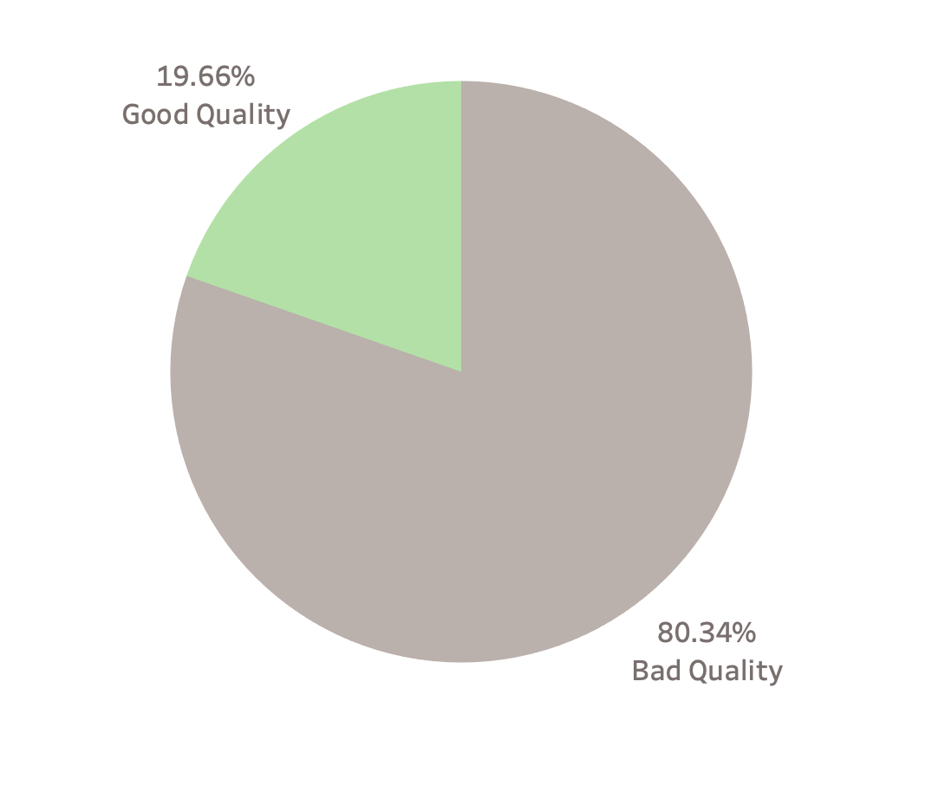
The Challenge
Classification!
Quality score was sensory based therefore individual linear scores were less informative than a binary classification.
Good wines are always hard to find and are the minority. Imbalanced distribution of wine qualities makes classification, difficult.
False positives present in grading make our clients lose reputation
False negatives make them lose money
It’s always the trade-off faced when we boost the classification to either have less false positives or false negatives.
Class Imbalance

Slide 5

False Negative vs False Positive
Falsely classifying a good wine as bad might result in losing money.
Falsely classifying a bad wine as good would hurt reputation. (Ultimately hurting a higher end brand that would result in overall loss of money).

Slide 6
The Solutions
We developed three models with three different metrics each to allow a winemaker to evaluate their business goals and select the one most suited to them.
Models:
Deep Learning
Logistic Regression
Scaled Vector Machine
Metrics:
Precision
Recall
Accuracy

Slide 7
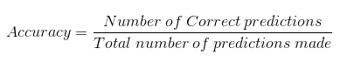
Metrics
Accuracy
The simplest of metric, accuracy works well when there are equal number of samples belonging to each class.
For our dataset, accuracy would be inflated to favor the majority class, bad wines, correctly labelling them more often than good wine correctly.

Slide 8
Confusion Matrix
Model Prediction
Bad Quality
(0)
Good Quality (1)
Bad Quality
(0)
True Negative
Correctly predicted
Bad Quality
False Positive
Incorrectly predicted
Good Quality
Actual Wine Quality
Good Quality (1)
False Negative
Incorrectly predicted
Bad Quality
True Positive
Correctly predicted
Good Quality

Slide 9
Testing Results
Deep Learning (n=1,625) | Predicted: (Bad Quality) | Predicted: (Good Quality)
Actual: (Bad Quality) | 1,244 (77%) | 62 (3%)
Actual: (Good Quality) | 211 (13%) | 108 (7%)
SVM (n=1,625) | Predicted: (Bad Quality) | Predicted: (Good Quality)
Actual: (Bad Quality) | 1,269 (78%) | 37 (2%)
Actual: (Good Quality) | 173 (11%) | 146 (9%)
Lowest False Negatives, Highest False Positives.

Slide 10
Testing Results
Print Test results (predictions) vs Actual for each model – as df
Logistic Regression Before SMOTE (n=1,625) | Predicted: (Bad Quality) | Predicted: (Good Quality)
Actual: (Bad Quality) | 975 (60%) | 331 (20%)
Actual: (Good Quality) | 260 (16%) | 59 (4%)
Lowest False Negatives,
Highest False Positives,
Highest True Positives,
Lowest True Negatives.
Logistic Regression After SMOTE (n=1,625) | Predicted: (Bad Quality) | Predicted: (Good Quality)
Actual: (Bad Quality) | 924 (57%) | 382 (23%)
Actual: (Good Quality) | 76 (5%) | 243 (15%)

Slide 11
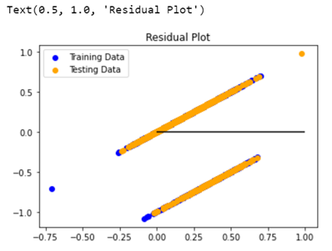
Multi-V Linear Model Disappointment
Given that the outcome of our data was linear, on a basis of 0-10 in quality ranking, we initially tried a multivariate linear regression.
Given that the quality was based on sensory input, we found that a multivariate linear model was not accurate, and determined that a logistic model of “good quality” vs “bad quality could be more effective.
With the knowledge that what is subjectively considered a “good” wine vs “bad” in terms of pricing, we created bins for for everything above average being classified as “good” and average or below classified as “bad”.

Slide 12
Metrics
Precision
Recall
Also called Positive predictive value.
The ratio of correct positive predictions to the total predicted positives.
Precision is a good measure when the cost of False Positive is high.
If a Bad Quality wine is incorrectly classified as Good Quality,
Reputation is at stake.
Also called Sensitivity, Probability of Detection, True Positive Rate.
The ratio of correct positive predictions to the total positives examples.
Recall is a good measure when the cost of False Negative is high.
If a Good Quality wine is incorrectly classified Bad Quality,
Money is at stake.

Slide 13
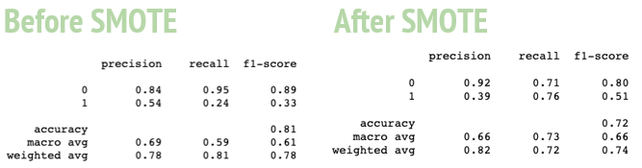
Logistic Regression
While overall accuracy appears to be worse after SMOTE, it was originally weighted to favor correct classification of bad wines and incorrect classification of good wines, due to the imbalance of samples in each class.
After SMOTE, Recall is improved, making it a better model for those more interested in not losing money by accidentally classifying a good wine as bad, as opposed to not hurting their reputation by classifying a bad wine as good.
SMOTE improves the overall accuracy of the Logistic Regression model by identifying the quality of wines, with improved accuracy in identifying the good wines as good
= Better pricing potential

Slide 14
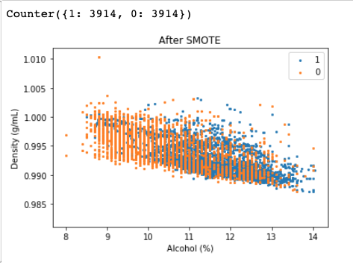
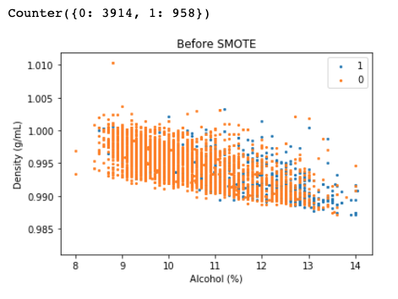
What is Smote?
Synthetic Minority Over-sampling Technique (SMOTE) is a machine learning algorithm that resolves class imbalance problem, such as when one class in the training set dominates the other.
Our data before SMOTE:
●958 Good Quality Wines (minority)
●3914 Bad Quality Wines (majority)
Our data after SMOTE:
●3914 Good Quality Wines (minority)
●3914 Bad Quality Wines (majority)
SMOTE imagines new, synthetic minority instances to balance the imbalance out.

Slide 15
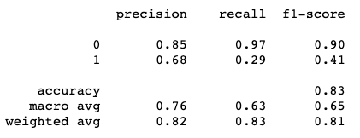
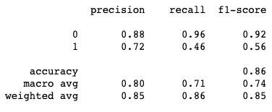
Support Vector Machine
Before GridCV
After GridCV
SMOTE improves the overall accuracy of the Logistic Regression model by identifying the quality of wines, with improved accuracy in identifying the good wines as good
= Better pricing potential
Notes:
Genevieve

Slide 16
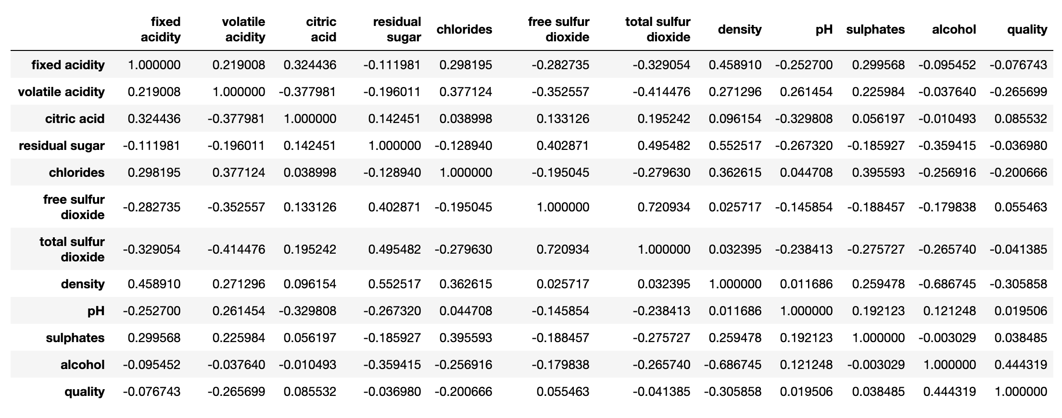
Correlation Matrix

Slide 17
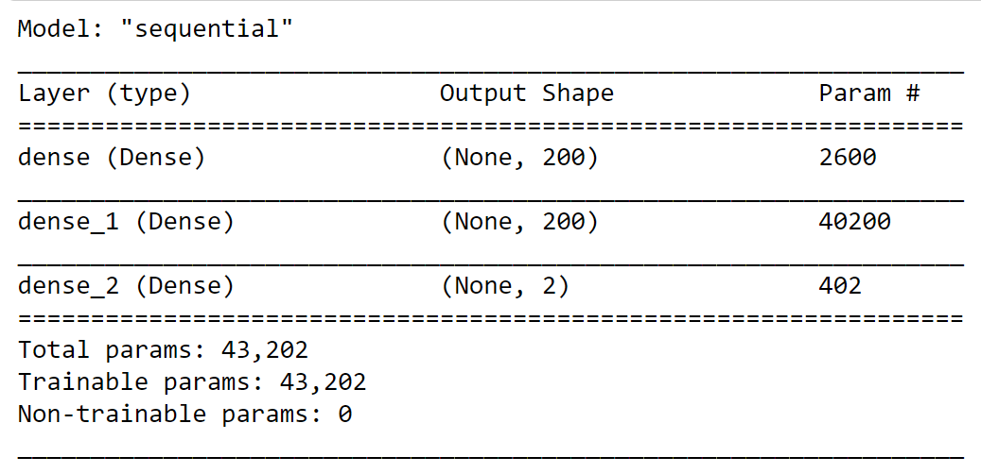
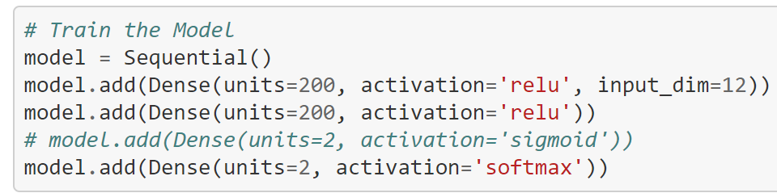
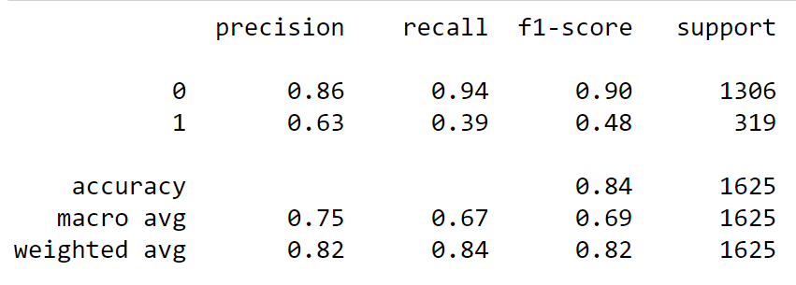
Deep Learning
Model Summary
Classification Report
Notes:
MARK

Slide 18
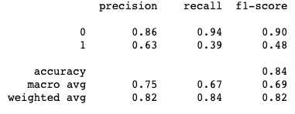
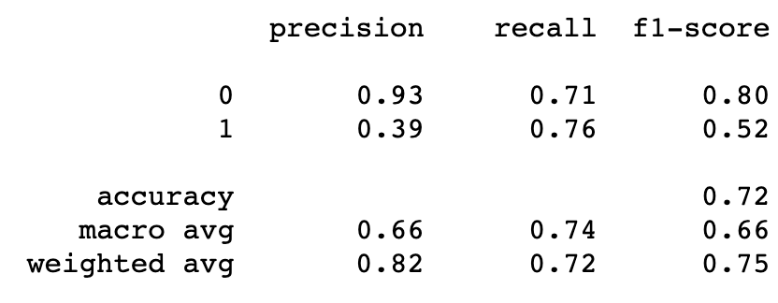
Model Comparison
Deep Learning
SVM with GridCV
Logistic with SMOTE
Highest Accuracy so the best balance of Precision and Recall.
Has the best Recall but worst Precision
REPUTATION VS PRICE - RISK BENEFITS
Notes:
Genevieve

Slide 19

QUESTIONS

